Slide 1

Console Review

Slide 2
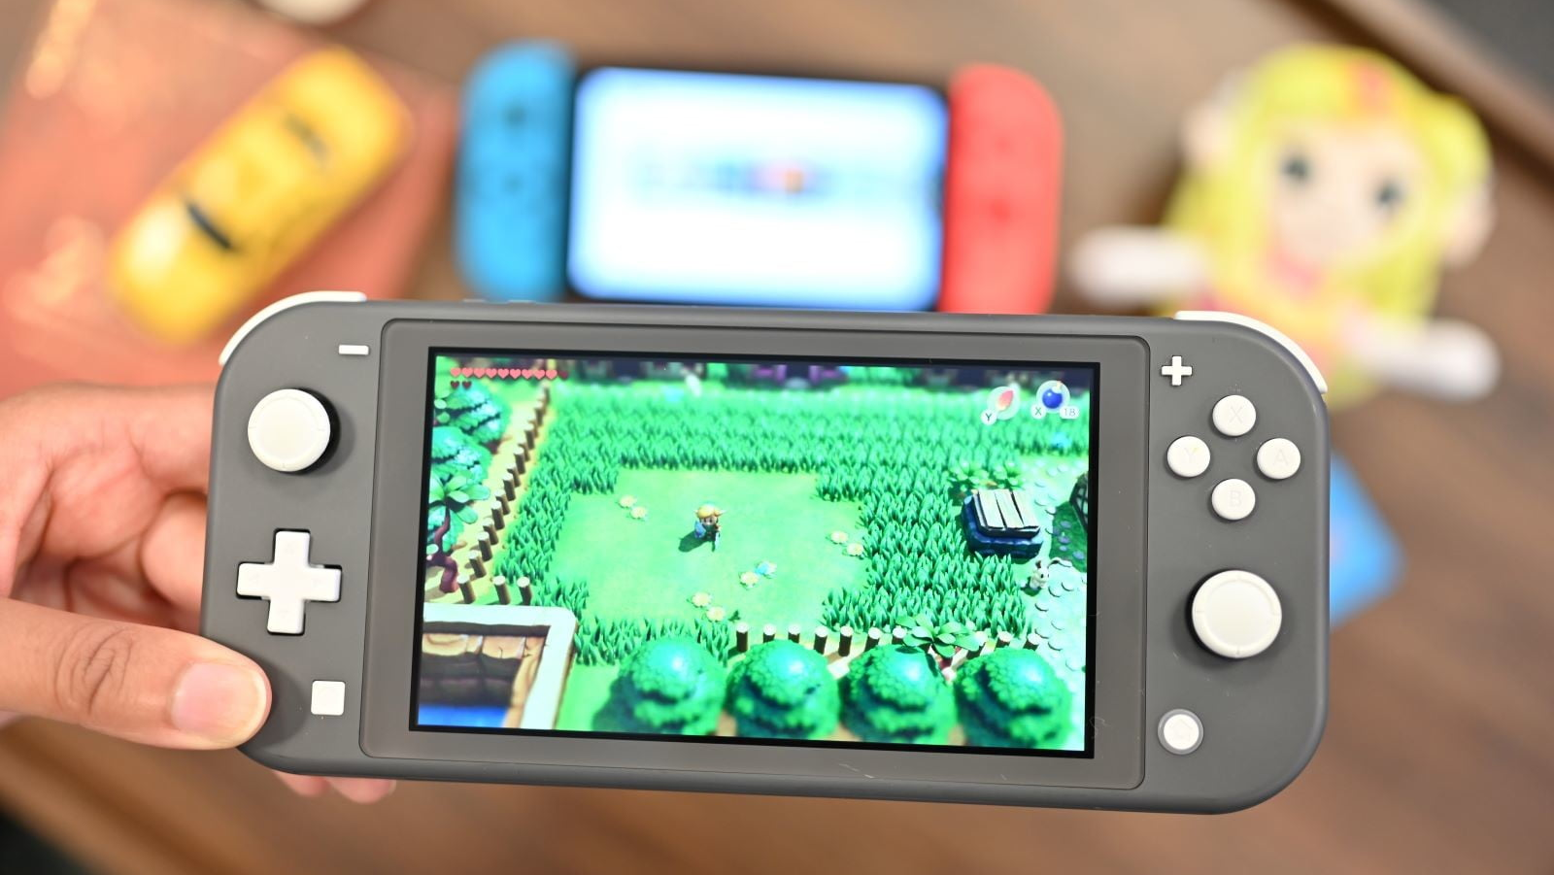
Nintendo Switch Lite
That's the main argument for the existence of the Switch Lite, but it doesn't hold water. Kids like to play video games on TV as much as adults do. The added cost is a concern, obviously, but paying the extra $100 is definitely worth it in this case. ... Simply put, the Switch Lite erases what made the original unique.

Slide 3
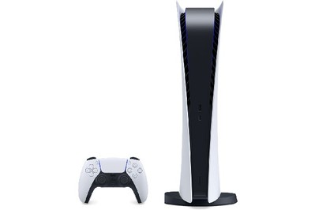
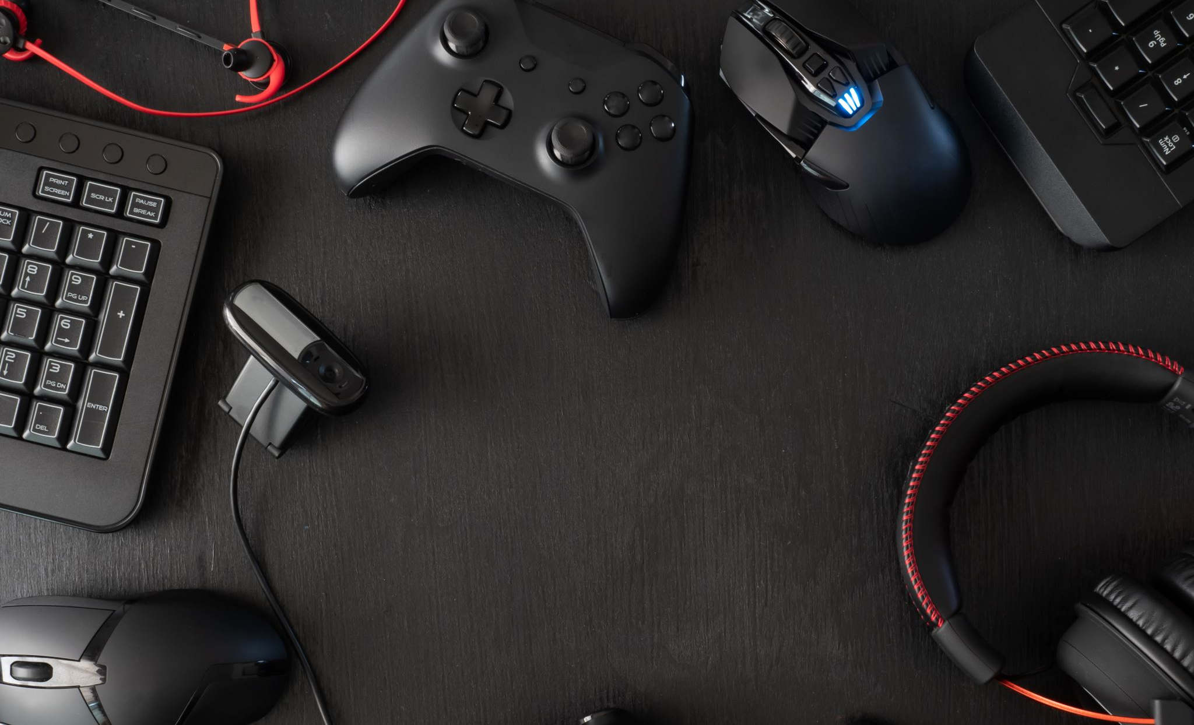
PlayStation 5 Digital Edition Console
The Digital Edition doesn’t include a disc drive, so you can’t watch Blu-rays or take advantage of new or used games, or old PS4 discs. But if you’re comfortable going all digital, it has the same graphics, CPU, memory, and storage hardware as the standard PS5.

Slide 4
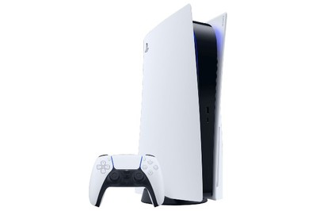
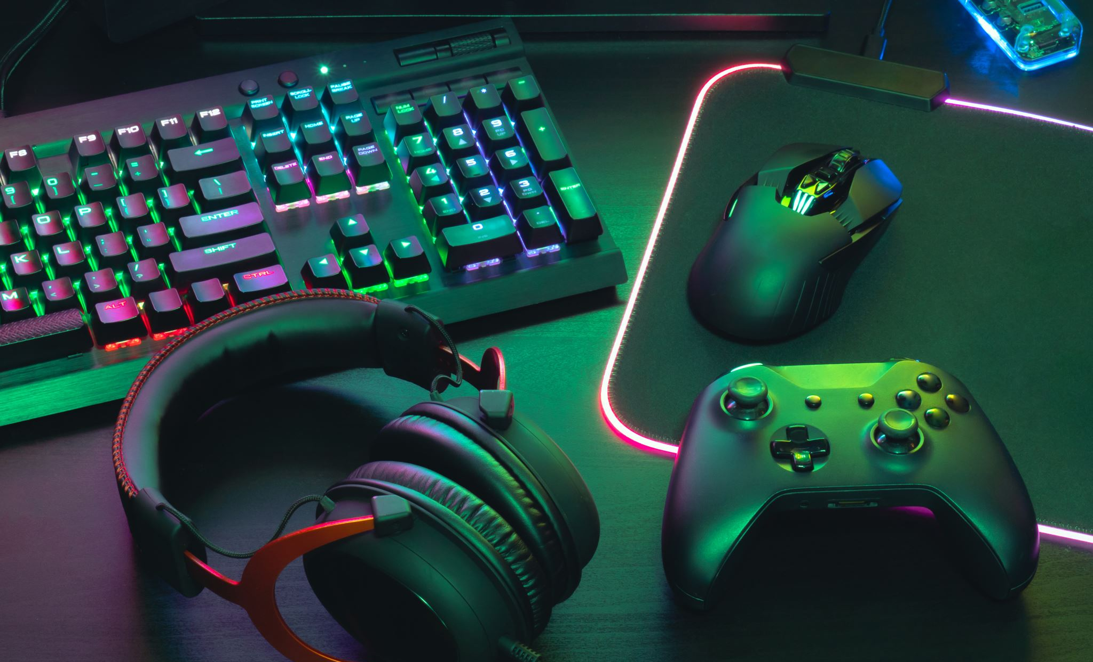
Sony PlayStation 5
The PlayStation 5 launched on November 12, though most retailers are already sold out of both the $500 PS5 and the $400 PS5 Digital Edition. With the PlayStation and Xbox platforms offering similar prices and graphics capabilities (at least on paper), the reasons to choose a PlayStation over an Xbox revolve mostly around which games you want to play and how you want to play them.

Slide 5
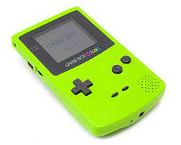
Game Boy Color
The average battery life is approximately 15 hours when playing Game Boy Advance games. This is somewhat less when playing Game Boy Color or Game Boy (original) games. Battery life can also vary depending on the Game Pak being used and the volume setting (louder=less play time).

